Slide 1
INTRODUCTION TO COMPUTER
Basic Computer Components

Slide 2
BASIC COMPUTER COMPONENTS
How do you define that an object is a computer?
Notes:
2

Slide 3
BASIC COMPUTER COMPONENTS
Monitor
The video display unit that sits on your desktop and serves as your computer screen.
Monitors are available in two basic types.
CRT (cathode ray tube - looks like a TV set), called "flat" or "perfect flat"
LCD (liquid crystal display) called "flat panel".
Notes:
3

Slide 4
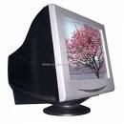
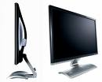
BASIC COMPUTER COMPONENTS
Monitor
CRT Monitor
LCD Monitor
Notes:
4

Slide 5
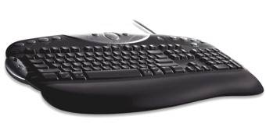
BASIC COMPUTER COMPONENTS
Keyboard
The peripheral device used to input information into a computer.
It provides a set of alphabetic, numeric, punctuation, symbol and control keys.
When a character is pressed, it sends a coded input to the computer, which then displays the character on the Monitor.
Keyboards are available in corded
and wireless models.
Keyboards should come with a
wrist rest.
Notes:
5

Slide 6
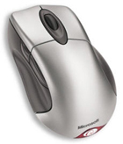
BASIC COMPUTER COMPONENTS
Mouse
A peripheral device connected to your computer, used to reposition the cursor or move the pointer on your screen.
Usually has at least two buttons, that is use to highlight text, open menu items, launch programs, etc.
Can be corded or wireless.
Some mice have a ball on the bottom that rolls as you push the mouse, and some mice have optical function.
Notes:
6

Slide 7
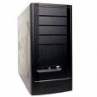
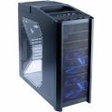
BASIC COMPUTER COMPONENTS
Case
Often called the “CPU”/ "computer", the case houses and provides power to the major computer components, including the MotherBoard, CPU, Hard Drive, RAM, Video Card, Sound Card, etc.
Those components that do not housed in the computer case are usually referred to as "peripherals".
Houses the power supply.
Notes:
7

Slide 8
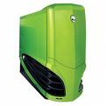
BASIC COMPUTER COMPONENTS
Case
It is important to have a large enough power supply to handle your current and future needs.
The case should be large enough and have enough ball bearing fans so the internal components do not overheat and cause damage to themselves.
Miniature cases are to be avoided.
Never put your computer in a desk compartment or other small space where it can't breathe. Heat is the enemy of all computers.
Notes:
8

Slide 9
BASIC COMPUTER COMPONENTS
MotherBoard
The main circuit board of the computer.
All key internal and external components of your computer plug into the MotherBoard, such as the CPU, RAM, Hard Drive, etc.
The speed at which information travels across the MotherBoard is referred to as the BUS speed.
Recently a new technology has been introduced called PCI Express. This allows a faster data transfer speed across the MotherBoard, especially for video graphics.
Notes:
9

Slide 10
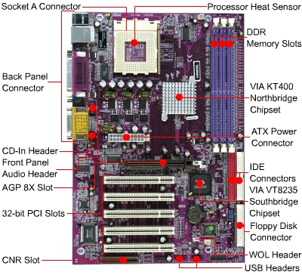
BASIC COMPUTER COMPONENTS
MotherBoard
Top View
Notes:
10

Slide 11
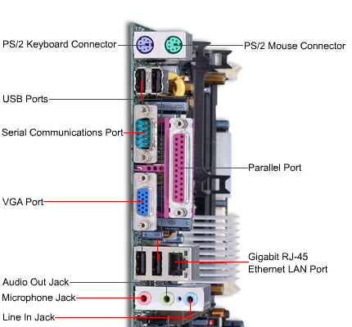
BASIC COMPUTER COMPONENTS
MotherBoard
Side View
Notes:
11

Slide 12

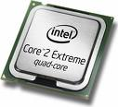

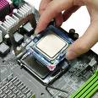
BASIC COMPUTER COMPONENTS
Central Processing Unit (CPU)
The most powerful microprocessor chip in your computer.
The speed of the CPU is measured in GigaHertz (billions of cycles per second).

Slide 13
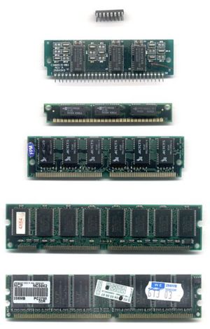
BASIC COMPUTER COMPONENTS
Random-Access Memory (RAM)
Hardware that stores information while you work.
One of the things that makes your computer run faster.
Not permanent storage of data. When you turn your computer off, all data in RAM is lost.
Available in different types, sizes, and speeds.
Notes:
13

Slide 14



BASIC COMPUTER COMPONENTS
Hard Drive
A Data Storage medium that houses all of the information in your computer.
This would include your operating system (OS), device drivers, programs, and data you have created using your programs (word documents, spread sheets, etc.).
Retains data when the computer is turned off.
Hard Drives sizes are in GigaBytes or billions of characters.
Notes:
14

Slide 15
BASIC COMPUTER COMPONENTS
Video Card
A circuit board that plugs into a MotherBoard slot, that handles multimedia applications and graphics-intensive web sites freeing up the CPU (thereby increasing your computers speed).
The monitor plugs into the video card which is accessed through a slot in the back of your computer.
The better the graphics chip on the video card, and the more RAM built on the video card, the faster the display on the monitor.
Better Video Cards have both Digital (better) and Analog outputs.
Notes:
15

Slide 16
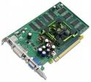
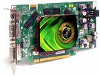
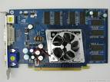
BASIC COMPUTER COMPONENTS
Video Card
Notes:
16

Slide 17
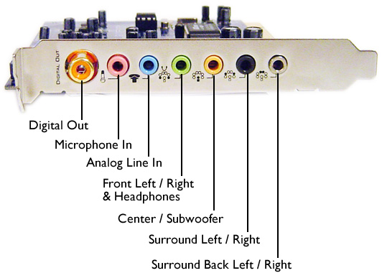

BASIC COMPUTER COMPONENTS
Sound Card
A circuit board that plugs into your MotherBoard that adds audio capability to your computer, providing high quality stereo output to the speakers .
Notes:
17

Slide 18
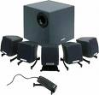



BASIC COMPUTER COMPONENTS
Speakers
Produce sound (music, voice, etc.) based on data created and sent by the sound card.
Today, computer speakers have become very high quality and many include a sub-woofer for good bass.
Notes:
18

Slide 19
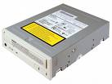
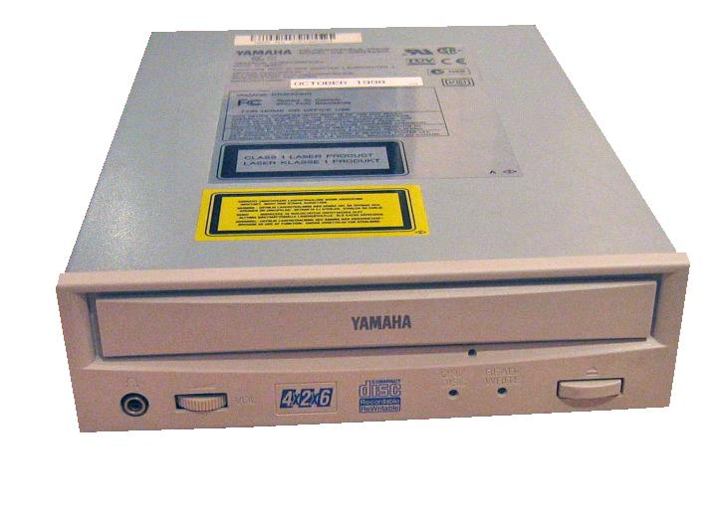
BASIC COMPUTER COMPONENTS
CD-ROM
Compact Disk - Read Only Memory.
An optical storage technology that stores and plays back data.
"Read Only" means the information can be displayed and used or copied, but cannot be deleted or changed (on the disk).
One CD-ROM can hold around 650 megabytes of data, or the equivalent of 450 floppies.
The speed of a CD-ROM refers to how fast the disk spins in the device.
Notes:
19

Slide 20
BASIC COMPUTER COMPONENTS
CD-Burner or DVD Burner
Informal name for a CD / DVD recorder, a device that can record data to a compact disc or DVD.
DVD and CD burners use different methods to transfer this data, depending on what type of data they are writing.
Almost all burners can do both tasks - record (CD-R/DVD-R) and rewrite (CD-RW/ DVD-RW).
CD burners are formatted to write audio and text files.
DVD burners are formatted to write audio and video files
Notes:
20

Slide 21
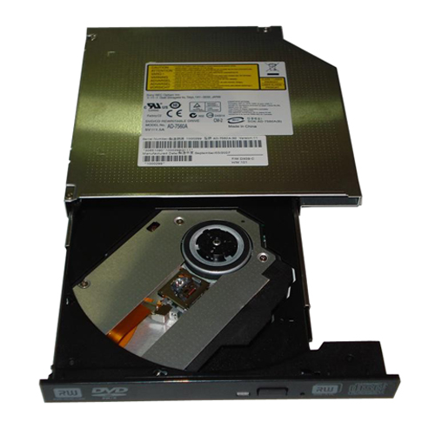
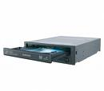
BASIC COMPUTER COMPONENTS
CD-Burner or DVD/CD Burner
Notes:
21

Slide 22
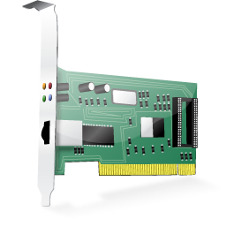
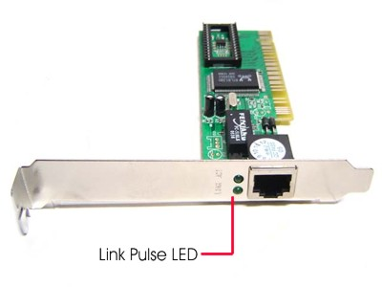
BASIC COMPUTER COMPONENTS
Ethernet Card
A circuit board that plugs into your MotherBoard and provides the capability to connect or "Network" your computer to other computers and/or the Internet.
If you use a cable modem, your computer will need an Ethernet card. Ethernet cards come in different speeds.eg: 10/100/1000 Mbps.
Notes:
22

Slide 23



BASIC COMPUTER COMPONENTS
Operating System
The foundation software of a computer system.
Responsible for controlling and launching the installed applications and computer peripherals.
It schedules tasks, allocates storage, handles the interface to peripheral hardware and presents a "default" interface to the user when no application program is running.
Notes:
23

Slide 24
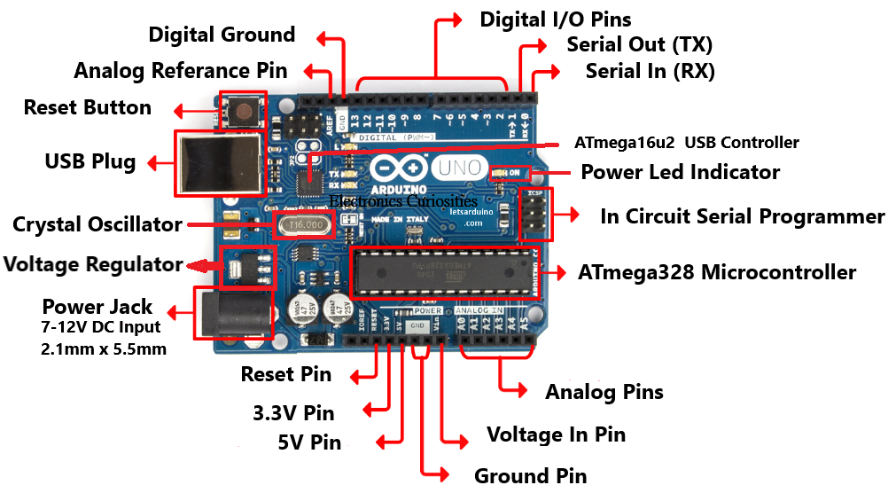
Arduino

Slide 25
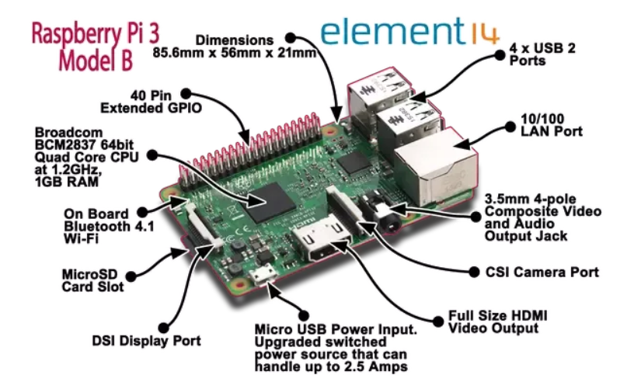
Raspberry pi

